Slide 1
Unit 5: Week 5
Grade K

Slide 2
Copyright © Savvas Learning Company LLC. All Rights Reserved.
This publication is protected by copyright, and permission should be obtained from the publisher prior to any prohibited reproduction, storage in a retrieval system, or transmission in any form or by any means, electronic, mechanical, photocopying, recording, or otherwise. For information regarding permissions, request forms, and the appropriate contacts within the Savvas Learning Company Rights Management group, please send your query to:
Savvas Learning Company LLC, 15 East Midland Avenue, Paramus, NJ 07652
or
k12learningpermissions@savvas.com
myView Literacy® is an exclusive trademark of Savvas Learning Company LLC in the U.S. and/or other countries.

Slide 3
Lesson 1

Slide 4
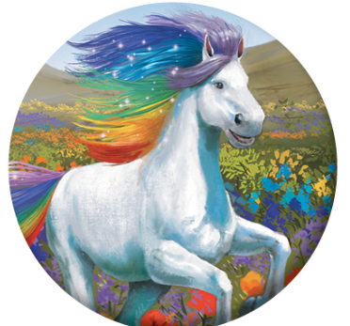
Page 124
Phonological Awareness
Notes:
Remind students that syllables are the beats we can hear in words. Today we are going to practice breaking apart and putting together word parts. Hold up pictures of the sea and a horse. This is a picture of the sea. This is a picture of a horse. Watch as I put the two parts together to say my word. Hold the pictures together. My word is seahorse. Now I will segment the word, or break it into parts again. Pull the pictures apart. The word parts are sea and horse. Have students blend and segment the syllables in seahorse as you put the pictures together and pull them apart.
Tell students that now they will play a game. Give two volunteers a picture of a sun and a flower. Ask students to guess what word the word parts might make together. Then have the volunteers put their pictures together as students blend the syllables to say the multisyllabic word. Have the volunteers pull the pictures apart as students segment the syllables. Continue with these pictures: jelly, fish; basket, ball; butter, fly.

Slide 5
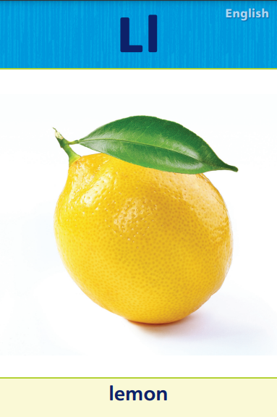
Page 166
Phonics
late
lap
lot
note
not
net
Notes:
Hold up the Ll Alphabet Card. What sound do you hear at the beginning of lemon? (/l/) What letter spells the sound /l/? (the letter l) Now let’s practice reading words with /l/ spelled l. Write the words late, lap, and lot on the board. These words have the sound /l/ spelled l. Circle the l in each word. Have students read the list. Repeat the activity to identify and match the sound /n/ with the letters Nn. Use the Nn Alphabet Card and these words: note, not, net. Click path -> Table of Contents -> Unit 5 Week 5 Drama -> Lesson 1
Continue the routine with the following words: lamp, name, nest, land, lit, nod.
Have students look at p. 166 in the Student Interactive. Have them read the sentences. Now you will circle the words that have /l/ spelled l and underline the words that have /n/ spelled n. Have students circle and underline the words, and then have them read the sentences again.

Slide 6
Page 166
Phonics
Turn to page 166 in your Student Interactive.
Notes:
Have students look at p. 166 in the Student Interactive. Have them read the sentences. Now you will circle the words that have /l/ spelled l and underline the words that have /n/ spelled n.
Have students circle and underline the words, and then have them read the sentences again.

Slide 7
High-Frequency Words
new
too
when
Notes:
Display the high-frequency words new, too, and when, and read them aloud.
Have students point to the word new and read it.
Repeat for too and when.

Slide 8
Page 164, 165
Interact with Sources
Draw one way elephants use water.
Notes:
Remind students of the Essential Question for Unit 5: What can we learn from the weather? Then point out the Weekly Question: How can rainy weather help Earth? Tell students that the weather is an important part of the world. Tell them that over the week they will learn about different kinds of weather and about how the weather affects our lives.
Use the following prompts to guide discussion:
Ask students to look at the top picture on p. 164 of the Student Interactive. Have them tell what they see.
Then read the callout on the left to students. Ask for volunteers to respond to the callout and the picture on the left-hand side of the page. Have them say what they see and how it relates to what you read.
Read the callout on the right-hand side of the page to students. Have volunteers respond by saying what they see and how it relates to what you read.
Have students interact with the infographic on p. 164 by drawing one way that elephants use rain water.
Remind students of the Week 5 Question: How can rainy weather help Earth? Tell students that elephants are part of Earth (or more precisely, that elephants are part of Earth’s ecosystems) because they are animals. Explain to them that when rain helps elephants, it is helping Earth, more generally. Tell them that over the week they will learn more about how rainy weather can help Earth.

Slide 9
Listening Comprehension
What happened?
Saul’s family gets home from vacation.
2.
3.
4.
Notes:
Tell students that you are going to read a drama to them. Explain to them that a drama is a story that can be acted out by people (sometimes called actors). The people in a drama are its main characters. Have students listen carefully. Suggest that they think about how the drama is like a story and how it is different.
Purpose Have students listen actively in order to identify the drama’s main characters.
Read the entire text aloud without stopping for the Think Aloud callouts.
Reread the text aloud, pausing to model Think Aloud strategies related to the genre.
Begin a list on the board of the main plot events that affect the drama’s main character, Saul. Have students think through and retell the story in order to think about the main character’s perspective and experience.

Slide 10
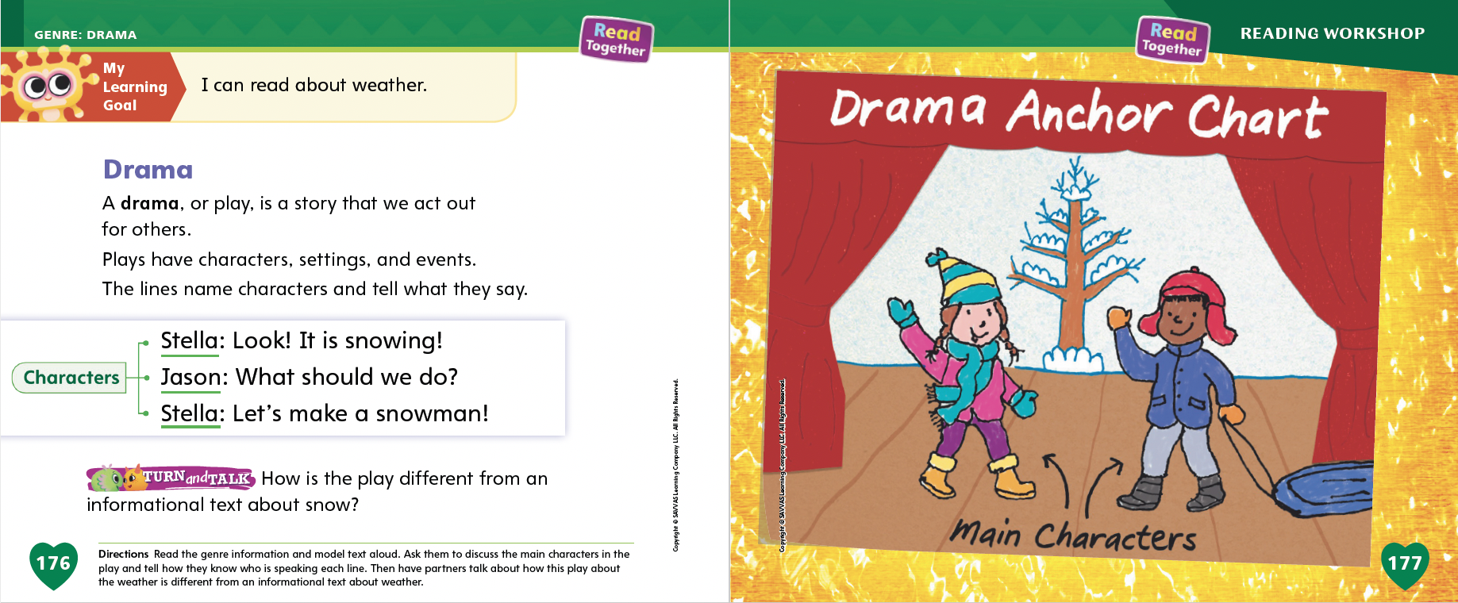
Page 176, 177
Drama Qualities
Turn to page
176 in your Student Interactive.
Notes:
Explain to students that they will learn about dramas, or plays, this week. Tell them that a drama is a story that is read or acted out for others.
A drama has main characters. The main characters are the people that the story is about.
A drama has a setting. The setting is where and when the drama happens.
A drama has events. Events are the parts of the drama’s plot. Events are what happens.
A drama has lines. The lines name the characters and tell what they say.
Review the information on p. 176 of the Student Interactive. Point out the characters and the lines they say. Act out the play, using different voices for the characters. Then have students practice acting out the characters. If they cannot read, suggest that they memorize or ad lib the lines. Tell students that a play tells the story through these lines of the characters.
Read the text and review the Anchor Chart on pp. 176-177 of the Student Interactive. Editable Anchor Chart Click Path: Table of Contents -> Reading Anchor Charts -> Unit 5 Week 5: Drama Editable Reading Anchor Chart

Slide 11
Page 176
Apply
How is the play different from an informational text about snow?
Notes:
Have students use strategies for identifying dramas.
Have students discuss the main characters in the play and complete the activity on p. 176 of the Student Interactive. Then have students discuss how the short play about snow might compare to an informational text about snow. Have volunteers share their discussion with the class.

Slide 12
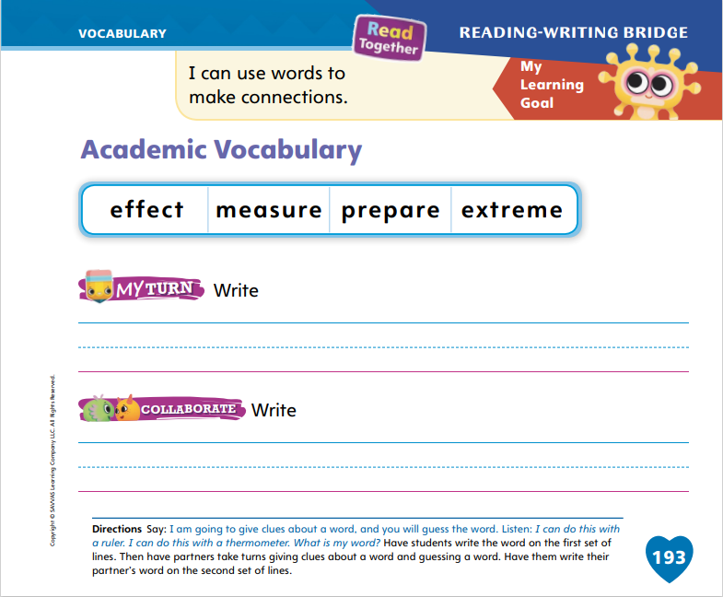
Page 193
Academic Vocabulary
Turn to page 193 in your Student Interactive.
Notes:
Explain to students that when they listen to others speak, they should listen for clues to the meanings of unfamiliar words.
Listen actively when others speak. The explanations they provide can give clues to word meanings.
Ask questions respectfully to clarify what you don’t understand.
Help students prepare to listen. Emphasize that they need to listen carefully to your words in order to complete the activity. Say: I am going to give clues about a word, and you will guess the word. Listen: I can do this with a ruler. I can do this with a thermometer. What is my word? Call on volunteers to give responses.
Guide students to understand that the word you are describing is measure. Then have students write the word measure on the appropriate lines on p. 193 of the Student Interactive.
Have students complete the Collaborate activity on p. 193 in the Student Interactive by working with partners to guess vocabulary words on the basis of orally provided clues.

Slide 13
Handwriting
I ran home.
I like to run.
Notes:
Write this sentence on the board: I ran home. Read it aloud to students. Tell students that this is a sentence. It begins with a capital letter, ends with a period, and has spaces between words.
Tell students that they will practice writing sentences. When we write sentences, we have to write multiple words, one after the other. We need to make sure we form each letter correctly. It is important to put a space between each word.
Model for students by writing another sentence, describing your strokes and pointing out each space as you go. Write this sentence on the board: I like to run. Point out the period at the end of the sentence.
Have students use Handwriting p. 276 in the Resource Download Center to practice writing simple sentences. Remind them to form the letters correctly and include spaces between words. Click path: Realize -> Table of Contents -> Resource Download Center -> Handwriting Practice -> U5W5L1 Handwriting Practice

Slide 14
Page 197
Writing – Literary Nonfiction
Turn to page 197 in your Student Interactive.
Notes:
Good writers go back and check their writing to ensure that they spelled each word correctly.
Tell students that good writers go back and revise their work to check for correct spelling.
Choose a stack text and point out some high-frequency words and words that follow certain spelling rules or patterns, such as CVC (cat) or CVCe (cake). Show students words with consonant blends, such as tr (trip) and fl (flat). Write the words on the board or flipchart and help students understand the spelling patterns. Have them think of other words that follow the same patterns (i.e., bat, sad, bake, late, trap, plug, grab).
Then choose a sentence from a stack text and write it on the board or flipchart. Spell one or two words incorrectly. Say: Today I will show you how to edit for spelling. Read the sentence aloud. Ask students if all the words are spelled correctly. When students have identified the misspelled words, show them how to edit. Explain the rule that helped you spell the word correctly. I’m going to cross out the misspelled word and write the word correctly above it. Repeat the activity with other high-frequency words until students show an understanding of editing for spelling.
Have students complete the activity on p. 197 of the Student Interactive. Have students work with a partner to check their spelling using an electronic dictionary. Provide assistance as needed.

Slide 15
Independent Writing
Revise words in your book that are spelled incorrectly. Then continue to revise your writing.
Share how you checked for misspelled words with the class.
Notes:
Tell students to review their book and revise words that are spelled incorrectly. Then have them continue working on revising their writing.
Writing Support
Modeled - Write a sentence with a misspelled word and model how to identify the word and correct it.
Shared - Ask students how they can find and correct misspelled words.
Guided - Guide students in using strategies to correct misspelled words.
Have a few students show their revisions to the class. Ask how they checked for misspelled words.

Slide 16
Spelling
Put the book on the table.
Please zip your jacket.
Tap your leg when you hear the sound.
We took a trip to the beach.
I like beets, and my sister likes them too.
I don’t know when I will be home.
Notes:
(Note: Move the orange boxes to cover each bold spelling word before you read aloud the words and sentences.)
Read aloud the words and sentences. Have students spell each word with initial consonant blends and the two high-frequency words.
Put the book on the table.
Please zip your jacket.
Tap your leg when you hear the sound.
We took a trip to the beach.
I like beets, and my sister likes them too.
I don’t know when I will be home.
Reveal the spelling word and have students check their work.

Slide 17
Language and Conventions
Skip is a dog.
Skip is a good dog.
Let’s practice adding adjectives to sentences.
Notes:
Remind students that they can expand sentences by using adjectives. To expand a sentence is to add words to provide details and meaning. Adjectives are descriptive words that tell more information about someone or something.
Model expanding sentences with adjectives for students. Write this sentence on the board: Skip is a dog. Read it aloud. Then write this sentence on the board: Skip is a good dog. Explain to students that the word good is an adjective. It tells more about Skip and adds meaning to the sentence.
Write a set of basic adjectives on the board, such as good, big, small, and happy. Have students say simple sentences, and then have them add one of the adjectives from the board to their sentences. Students can complete this activity working in pairs, or you can run the activity with the whole class, calling on volunteers to say and then expand sentences.

Slide 18
Lesson 2

Slide 19
Page 167
Phonics
river
zigzag
Notes:
Hold up the Rr Alphabet Card. This is a picture of a river. I hear the sound /r/ at the beginning of river. What letter spells the sound /r/ in river? Students should say r. Write the word river on the board and ask a volunteer to circle the letter r at the beginning of river.
Hold up the Zz Alphabet Card. This is a picture of a zigzag. I hear the sound /z/ at the beginning of zigzag. What letter spells the sound /z/ in zigzag? Students should say z. Write the word zigzag on the board and ask a volunteer to circle the letter z at the beginning of zigzag. Click path -> Table of Contents -> Unit 5 Week 5 Drama -> Lesson 2
Have students turn to p. 167 in the Student Interactive. Read the first sentence with students. Guide students as they trace the word red on the line. Then have students read the completed sentence.

Slide 20
Page 167
Apply
Turn to page 167 in your Student Interactive and complete the activity.
Notes:
Have students complete the rest of p. 167 in the Student Interactive.

Slide 21
High-Frequency Words
new
too
when
Notes:
Tell students that high frequency words are words that they will hear and see over and over in texts.
Write and read the words new, too, and when.
Have students
repeat the words after you.
spell each word, clapping as they say each letter.

Slide 22
Page 178
Preview Vocabulary
rain
dirt
seeds
Notes:
Tell students you will start by learning some words that are in the text. Introduce the words: rain, dirt, seeds.
Ask students what they already know about these words. Ask questions, such as: What is rain like? Where do you find dirt? What are seeds? Where do seeds come from? Have you ever seen seeds?
Have students respond to your questions by telling what they already know about the words. Invite students to use physical gestures to represent rain; if appropriate, have them draw a picture for dirt and seeds.
These words will help us understand what the text is about. We want to be able to understand what is going on in the story. We want to be ready to enjoy the text.

Slide 23
Page 179
First Read Strategies
Notes:
Discuss the First Read Strategies. In this first read, encourage students to read for understanding and enjoyment. After students complete the First Read, ask: What did you like most? What did you learn? What surprised you? What did you already know?
First Read Strategies
READ Read or listen to the text. The text is a play, and it has different characters. Pay attention to which character is speaking as you read.
LOOK Look at the pictures to help you understand the text.
ASK Generate, or ask, questions about the text to deepen understanding.
TALK Talk to a partner about the text.
Help students read the whole text independently, in pairs, or as a whole class. Use the First Read notes to help students connect with the text and to monitor comprehension.

Slide 24
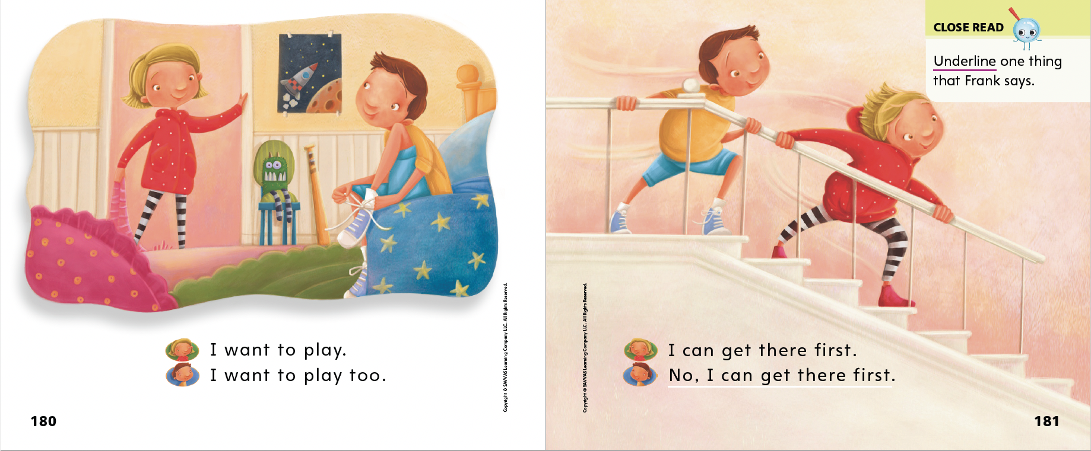
Page 180, 181
First Read – Who Likes Rain?
Notes:
Read Together.
THINK ALOUD On the first page, Jenna and Frank say that they want to play. Each of them says, “I want to play.” I ask myself: Will Frank and Jenna be able to play? Will they have fun? Where will they play? As I keep reading, I will look for answers to my questions.

Slide 25
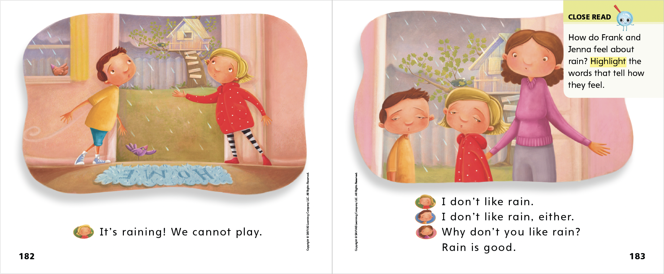
Page 182, 183
First Read – Who Likes Rain?
Notes:
Read Together.

Slide 26
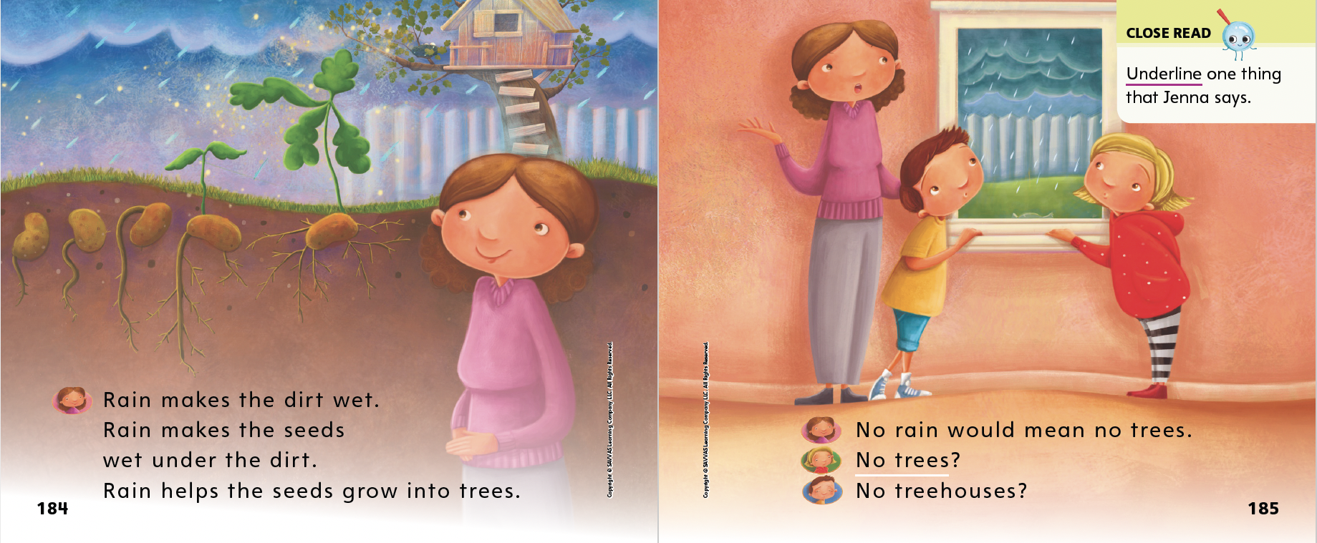
Page 184, 185
First Read – Who Likes Rain?
Notes:
Read Together.
THINK ALOUD As I finish reading the story, I can think about why I read it. This story is about rain and why rain is important. Part of my purpose for reading was to learn about how rain can help Earth. There are many words in the story that tell about rain and about how it can help Earth. I’ll talk with a partner about what I learned.

Slide 27
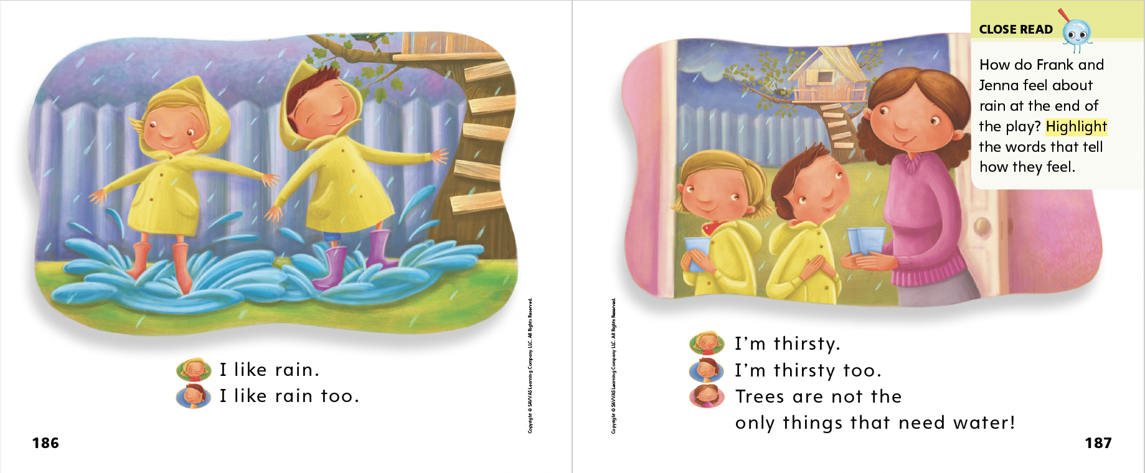
Page 186, 187
First Read – Who Likes Rain?
Notes:
Read Together.

Slide 28
Respond and Analyze
Talk: Is rain good for Frank and Jenna, or is it bad for them?
Draw: Draw the part of the story that you liked the most.
Notes:
Prompt students to respond to the text. Ask them what they thought about the different characters in the play and about the story of the play.
Talk Lead a class discussion about why rainy weather matters in the story. Why does it matter for the characters? Is rain good for Frank and Jenna, or is it bad for them?
Draw Have students draw their intuitive responses to the text. Prompt them to draw the part of the story, or the idea in the story, that they liked most.

Slide 29
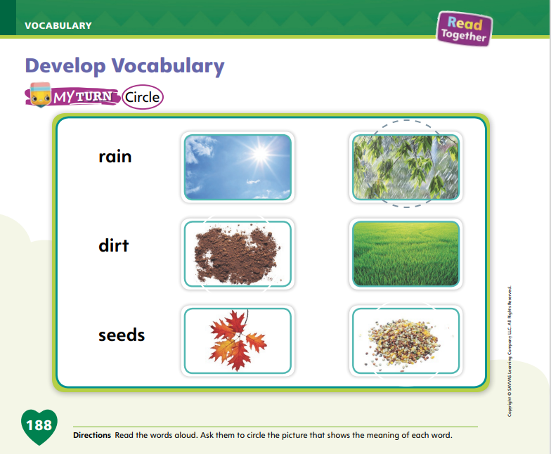
Page 188
Develop Vocabulary
Turn to page 188 in your Student Interactive and complete the activity.
Notes:
Explain to students that the words rain, dirt, and seeds are very important in the story. These words name parts of nature, or parts of Earth, that show why rainy weather is important and helpful. Tell students that pictures can help them clarify the meanings of these important words.
READ Read each word.
THINK Think about what each word means, based on what you remember from reading.
LOOK Look at the pictures, and ask yourself which picture most closely matches the meaning of each word, based on what you know.
Instruct students to turn to p. 188 in the Student Interactive. Model how to complete the activity using the word rain. Which of these two pictures shows rain? Let’s look carefully at the pictures. Think about what the word rain means. Which picture matches this meaning? Guide students to circle the picture on the right.
Have students practice developing vocabulary by completing p. 188 of the Student Interactive.

Slide 30
Page 189
Check for Understanding
Turn to page 189 in your Student Interactive and complete the activity.
Notes:
Have students complete the Check for Understanding on p. 189 of the Student Interactive.

Slide 31
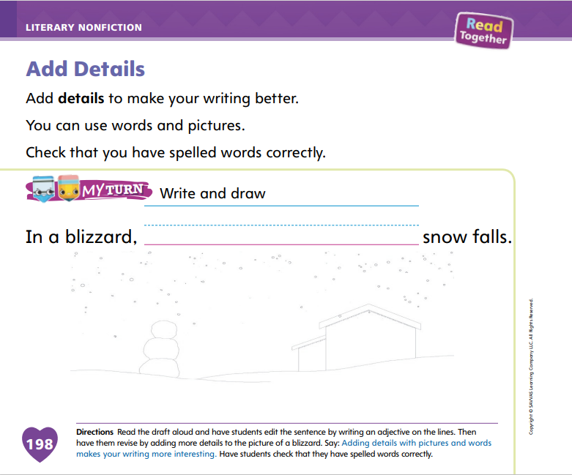
Page 198
Writing – Literary Nonfiction
Turn to page 198 in your Student Interactive and complete the activity.
Notes:
Details give readers more information about a topic. Details also make a book more interesting. In question and answer books, authors can add details to the question, answer, or pictures. Details can be adjectives to describe a naming part of the sentence, or they can be nouns or verbs added to the action part of the sentence. Details can also be added to pictures.
Use stack texts to point out how details in a picture add information to the book and make it more interesting. Point out adjectives in sentences, explaining how these descriptive words add details too. Tell students that today they will edit their books, paying attention to places they can add details in words and pictures and places they can add or edit adjectives.
Write a sentence on the board about a picture in a stack text. Do not include describing information. For example: This elephant has a nose. Tell students you will add details to the sentence. Say: I can see that the elephant is gray and that it is using its long nose to spray itself with water. I can change the sentence to: This gray elephant has a long nose that sprays water. Refer to the pictures to think about the details to add to the sentence.
Repeat the activity, using another picture from a stack text. Have students make the sentence more descriptive by adding details to it.
Have students complete the activity on p. 198 in the Student Interactive. Remind students that they can use both words and pictures to show details.

Slide 32
Independent Writing
Review your books and add more details.
Share where you added details and explain why you added them.
Notes:
During independent writing, students should review their books and add more details. .
Writing Support
Modeled - Go back to a student’s writing and model adding details to words or pictures.
Shared - Have students share their ideas about where to add details to their writing or pictures.
Guided - Use a stack text to provide explicit instruction about how details can be added to words or pictures.
Then they should continue editing and finalizing their books in preparation for the celebration.
Call on a few students to show where they added details. Prompt students to explain why they added those details.

Slide 33
Page 194
Spelling
Turn to page 194 in your Student Interactive and complete the activity.
Notes:
Explain that spelling rules can help students spell words with short vowel sounds and blends. Review the VC, CVC, and CCVC spelling patterns with students.
Have students look at the first word on p. 194 in the Student Interactive. It is the word too. Does too have a short vowel sound? No, so we will write too in the second column.
Have students complete the activity on p. 194 in the Student Interactive independently or with support from you.

Slide 34
Language and Conventions
Bob is happy.
Bob is happy with me.
I went to school.
I went to the store.
Revise sentences by adding a prepositional phrase.
Notes:
Tell students that they can expand sentences and make them more meaningful by adding phrases. Suggest that students use phrases that tell more about how things are related. These phrases will often include words such as beside, near, over, and with. Remind students that these are prepositions.
Write this sentence on the board: Bob is happy. Read it aloud. Then write this sentence on the board: Bob is happy with me. Read it aloud. Tell students that you added the phrase with me. This phrase adds more information and meaning to the sentence. Remind students that it is a prepositional phrase.
Say to the class: I went to the store. Call on a volunteer to revise your sentence by adding a prepositional phrase. Then say to the class: I went to school. Call on a volunteer to revise your sentence by adding a prepositional phrase. Repeat the activity, calling on as many students as possible. Use the sentence frame: I went to ______. to prompt students.

Slide 35
Lesson 3

Slide 36
Phonological Awareness
bookshelf
raindrop
cookbook
backdrop
backpack
Notes:
Remind students that syllables are the beats we can hear in words. Today we are going to practice making new words with different word parts. Hold up a picture of a bookshelf. Model manipulating the syllables in the multisyllabic word. My word is bookshelf. The word bookshelf has the word parts book (pause) shelf. Now I will take away the second word part to make a new word: book. Hold up a picture of a book. My new word is book. Now I will add a new word part to the beginning of my word to make another word. I will add the word part cook: cook (pause) book. Hold up a picture of a cookbook. My new word is cookbook.
Say the multisyllabic word rainbow. Ask students to identify all syllables in the word. Then have them manipulate, or control, the syllables by taking away the second syllable and saying the new word. (rain) Continue having students add and take away syllables to make the following word chain: raindrop, drop, backdrop, back, backpack.

Slide 37
Page 168
Phonics
lamp
Turn to page 168 in your Student Interactive and complete the activity.
run
zap
Notes:
Write the word lamp on the board. This is the word lamp. I can read the word: /l/ /a/ /m/ /p/, lamp. What letter spells the sound /l/ at the beginning of lamp? (the letter l) Write run on the board. This is the word run. I can read the word: /r/ /u/ /n/, run. What letter spells the sound /r/ at the beginning of run? (the letter r) What letter spells the sound /n/ at the end of run? (the letter n) Write zap on the board. This is the word zap. I can read the word: /z/ /a/ /p/, zap. What letter spells the sound /z/ at the beginning of zap? (the letter z)
Listen as I say these sounds: /l/, /n/, /r/, /z/. Have volunteers identify the letter that spells each of the sounds.
Have students turn to p. 168 in the Student Interactive. Have partners take turns reading the sentences on the page.

Slide 38
Page 169
High-Frequency Words
new
Turn to page 169 in your Student Interactive and complete the activity.
too
when
Notes:
Tell students that today they are going to continue practicing the high-frequency words for this week. You will see these words over and over in texts. Have students read the words at the top of p. 169 in the Student Interactive with you: new, too, when.
Have students look at the words at the top of p. 169. Tell them to identify and point to each word when you say it. Say when. Pause to let students find and point to the word. Say new. Say too. Repeat the activity until students are familiar with each word. Prompt students to use the words in sentences.

Slide 39
Page 179
Discuss Characters in Drama
Notes:
Characters are the people in a play, or drama. They move the story forward with their speech and actions.
LISTEN Characters speak lines in plays; they talk to each other.
THINK Characters take part in plot events. Like stories, plays have main events, problems, and resolutions. These events have effects on characters.
LOOK Characters look a certain way. When a play is acted out on stage, you can see each character.
Knowing about the characters is important to understanding a play. By discussing characters, you can gain a much deeper understanding of the play.
Model for students how to reflect on and discuss one of the characters in the play they just read. First, show students how to raise questions about a character. Then model how to answer them. One character in the play is Jenna. What does Jenna say in the play? Which events have an effect on her? What does Jenna look like? What is she wearing? Jenna says she wants to play outside. She is sad because she can’t go outside in the rain. Mom talks to Jenna about rain, and this makes Jenna like the rain! Jenna is a girl; she has blonde hair and wears a red shirt.
Remind students that the play has other characters, too. Ask them to practice by discussing Jenna further. Prompt students to discuss Jenna by asking and answering questions about her.

Slide 40
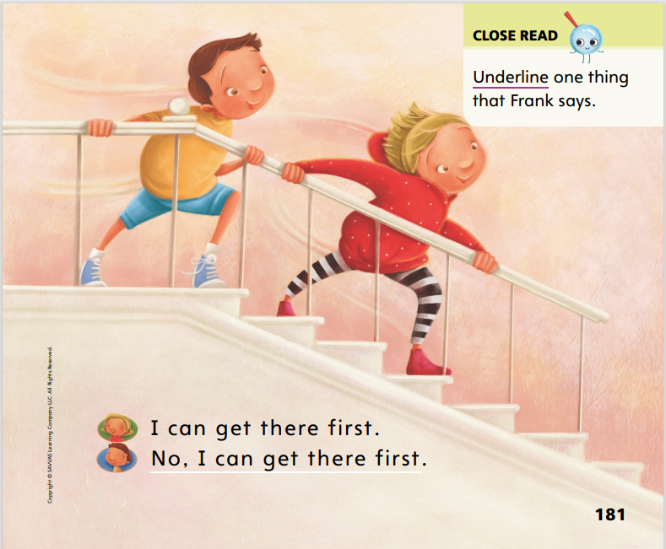
Page 181
Close Read – Discuss Characters in Drama
Turn to page 181 in your Student Interactive.
Notes:
Read aloud the Close Read note on p. 181. Help students understand that the icons show who is saying the words on the page. DOK 2

Slide 41
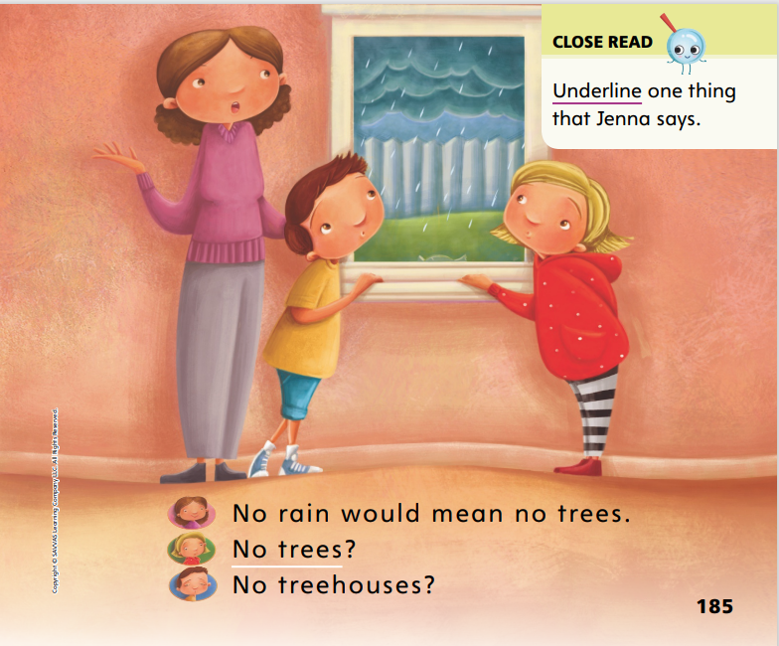
Page 185
Close Read – Discuss Characters in Drama
Turn to page 185 in your Student Interactive.
Notes:
Say to students, One of the characters in the play is Jenna. Can you find one thing that Jenna says? Have them underline what Jenna says on p. 185. DOK 1

Slide 42
Page 190
Discuss Characters in Drama
Turn to page 190 in your Student Interactive and complete the activity.
Notes:
Have students use the strategies for identifying and discussing the characters in a drama.
Have students complete p. 190 in the Student Interactive.

Slide 43
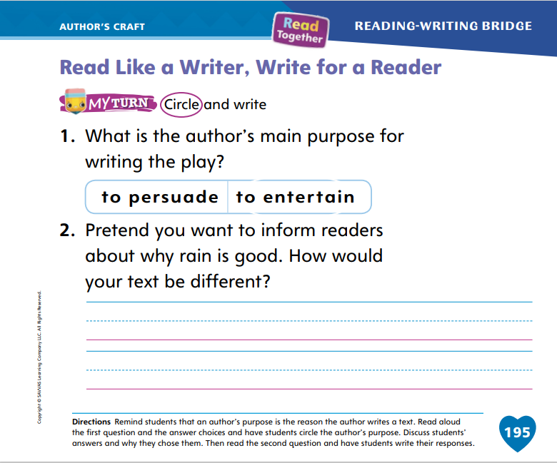
Page 195
Read Like a Writer, Write For a Reader
Turn to page 195 in your Student Interactive and complete the activity.
Notes:
Remind students that authors write texts for different reasons. The reason an author writes a text is called the author’s purpose.
Informational texts tell facts about a topic.
Persuasive texts provide a viewpoint, or opinion, about a topic.
Fictional texts tell a story to entertain or teach a lesson.
Remind students about the play they read (Who Likes Rain?) and ask them to say the author’s purpose for writing it. Guide them to the conclusion that the play was written to entertain.
Have students complete p. 195 in the Student Interactive by identifying the author’s purpose and answering the genre-related question.

Slide 44
Handwriting
My pet is a cat.
Notes:
Write this sentence on the board: I like my pet. Tell students that this is a sentence, and read it aloud. Point out the spaces between the words and the period at the end.
Write this sentence on the board: My pet is a cat. As you write, describe your strokes and point out each space. Say: This is a sentence. A sentence begins with a capital letter and ends with a period. Each word in a sentence is separated from the others by a space. Each letter is formed correctly.
Have students use Handwriting p. 277 in the Resource Download Center to practice writing simple words and sentences. Remind students to form letters accurately and include spaces between words. Click path: Realize -> Table of Contents -> Resource Download Center -> Handwriting Practice -> U5W5L3 Handwriting Practice

Slide 45
Writing – Literary Nonfiction
Book Checklist:
Questions that use 5Ws and the H
Answers
Introduction
Conclusion
Writing Checklist:
Edit for spelling
Edit for action words
Add details too graphics and text
Notes:
When authors are finalizing their work, they plan a celebration. The celebration may be a public reading. Using what they learned this week, students will continue to revise their work and prepare for a celebration of their writing.
As a class, make a Writing Checklist that students can refer to as they edit and finalize their books. Checklists should incorporate what students learned in this unit. Question and answer books should include
questions that use the 5 Ws and the H.
answers that give information about a topic.
an introduction that describes the topic.
a conclusion that reminds readers about the topic.
This unit’s Writing Checklist can also include:
edit for spelling
edit for action words
add details to graphics and text
Before displaying the checklist, read through it as a class and answer any questions students may have. Remind students to refer to it as they revise.

Slide 46
Independent Writing
Continue writing and editing your book.
Share something you revised with the class.
Notes:
Tell students to use the checklist to revise the books they wrote during this unit.
Writing Support
Modeled - As you look through student work, model using the checklist to revise.
Shared - Have students identify how their work can be revised as they refer to the checklist.
Guided - Prompt students to read the sentences in their books and direct them to the checklist to revise.
Students who demonstrate understanding should work to finalize their question and answer books.
Call on a few students to share something they revised. Tell students to discuss why it is important for writers to add details and check for spelling and to use a checklist before publishing their books.

Slide 47
Spelling
brim
drip
not
beg
Notes:
Remind students that words with short vowel sounds and blends can be easy to spell because they often follow rules.
Have students write the following words, as you isolate each phoneme: brim—/b/ /r/ /i/ /m/; drip—/d/ /r/ /i/ /p/; not—/n/ /o/ t/; beg—/b/ /e/ /g/.
Have students complete Spell Words p. 282 from the Resource Download Center. Click path: Table of Contents -> Resource Download Center -> Spelling -> U5W5L3

Slide 48
Language and Conventions
I had fun.
I had fun at the party.
Expand the sentence I had fun.
Notes:
Explain to students that there are many ways to expand a sentence. Adding a prepositional phrase to a sentence is a good way to add more information to it. Say the sentence: I want to eat lunch. Then tell students that you are going to expand the sentence. Say: Here are some ways I can expand my sentence:
I want to eat lunch at home.
I want to eat lunch at school.
I want to eat lunch with my friend.
I want to eat lunch near a mountain!
Introduce students to another sentence stem that can be expanded: I had fun. Model expanding this sentence for students by saying: I had fun at the party. Prompt students to attempt their own expansions of the sentence, I had fun.

Slide 49
Lesson 4

Slide 50
Page 170, 171
Decodable Story
new
too
when
Turn to pages 170, 171 in your Student Interactive. We will Read “Going Out.”
Notes:
Have students turn to p. 170 in the Student Interactive. We are going to read a story today about some people who go out in the rain. Point to the title of the story. The title is Going Out. In this story, we will read words that have the sounds /l/, /n/, /r/, and /z/.
Remind students of this week’s high-frequency words: new, too, when. Tell them they will practice reading these words in the story Going Out. Display the words. Have students read them with you. When you see these words in the story Going Out, you will know how to identify and read them.
Have students whisper read the story as you listen in. Then have students reread the story with a partner. Listen carefully as they use letter-sound relationships to decode words. Partners should reread the story. This time the other student begins.
After students have read the story, review the words with the letter z they read in the sentences on pp. 170–171. Have them underline the words with the letter z and then read the words with you.

Slide 51
Page 172, 173
Decodable Story
Notes:
Have students turn to p. 172. I see some words with the letter for the sound /n/. Who can tell me which words have the sound /n/? Students should identify these words: when, not. Have students highlight when and not. Direct students to find and highlight the word with the sound /n/ on p. 173.
I see two high-frequency words we learned this week on these pages. Who can point to the words and read them to me? Have a volunteer point to and read the words when and too.

Slide 52
Page 179
Create New Understandings
Notes:
Readers can think about different parts of a text and synthesize details to create new understandings. That means they put together details they read to come up with a new idea about the text.
Look through the play. What details can you find about the characters or events?
Think about the details. What connections can you make?
Put the details together. What new understanding can you create from the details you found?
Model for students how to create new understandings for Who Likes Rain? Have students look at the picture of Frank on p. 183 of the Student Interactive. Frank is frowning here. I think he must feel sad. He probably feels sad because it is raining outside. Have students look at the pictures of Frank on pp. 186–187. What does Frank look like here? How do you think he feels now? Why do you think he feels that way now? Listen to students’ responses, and guide them to conclude that Frank is smiling and probably feels happy because he now knows that rain is good.

Slide 53
Page 182, 183
Close Read – Create New Understandings
Turn to page 182, 183 in your Student Interactive.
Notes:
On pp. 182–183 readers can use the words and pictures to figure out how the characters feel. Read aloud the Close Read note and ask students to highlight words that show how Frank and Jenna feel. DOK 2

Slide 54
Page 186, 187
Close Read – Create New Understandings
Turn to page 186, 187 in your Student Interactive.
Notes:
Read aloud the Close Read note on p. 187. Have students share how the words help them understand the characters or the story. DOK 2

Slide 55
Page 191
Create New Understandings
Turn to page 191 in your Student Interactive and complete the activity.
Notes:
Have students use the strategies for creating new understandings.
Have students complete p. 191 of the Student Interactive to demonstrate understanding of how Frank’s and Jenna’s feelings changed over the course of the play.

Slide 56
Page 199
Writing – Literary Nonfiction
Turn to page 199 in your Student Interactive.
Notes:
One way authors celebrate their writing is to read it aloud. The audience listens attentively and may ask questions after the reading.
Display a book you have written or a book from the stack. Explain that you will celebrate by reading it aloud to the class. Do a Think Aloud before sharing, recalling what to do when speaking to the class. For example: First I’ll introduce myself and read the title of my book. Then I’ll begin reading clearly and loudly so the audience can hear me. Please wait until I finish reading before asking questions or making suggestions.
Hold up the book and introduce yourself and read the title. Read slowly and clearly. After reading, ask students if they have suggestions or questions about the book. If students have suggestions, accept or reject them, giving reasons for doing so.
Have students review the reminders on p. 199 in the Student Interactive. Then have students practice sharing their writing.

Slide 57
Independent Writing
Share your writing with the class.
As you listen to others, ask questions and provide positive feedback and suggestions.
Notes:
Have students share their writing with the class.
Prompt students to ask questions and provide positive feedback or suggestions.

Slide 58
Spelling
slid
flag
skip
trap
stem
Notes:
Have students recall the previous spelling rules for spelling words with the CCVC consonant blend pattern.
Read the following words and have students spell them: slid, flag, skip, trap, stem.
Have pairs work together to sort the words according to their spelling rules.

Slide 59
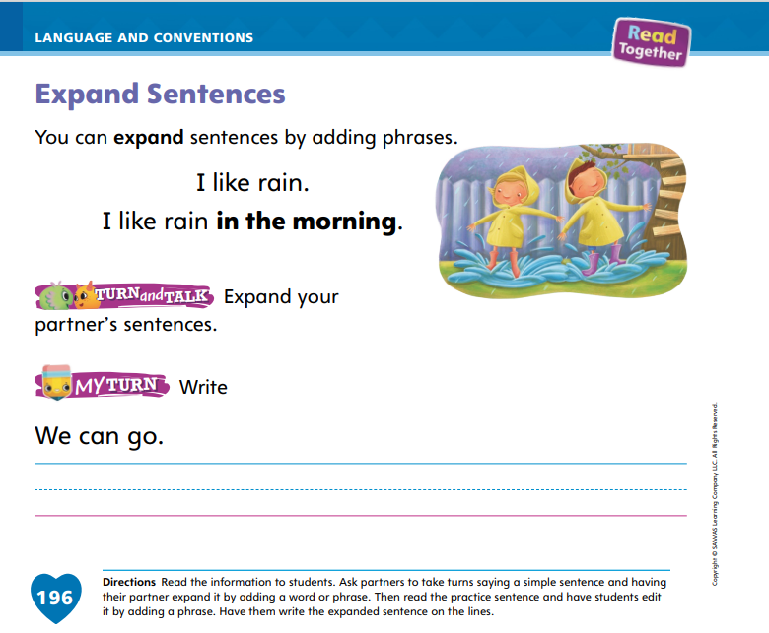
Page 196
Language and Conventions
Turn to page 196 in your Student Interactive and complete the activity.
Notes:
Have students complete the Turn and Talk activity and the My Turn activity on p. 196 of the Student Interactive.

Slide 60
Lesson 5

Slide 61
Phonological Awareness
fun
fan
man
Notes:
Tell students that when we change a sound in a word, we make a new word. Listen carefully as I say the sounds in the word sand: /s/ /a/ /n/ /d/. What are the sounds you hear in sand? Students should say /s/ /a/ /n/ /d/. Let’s change the beginning sound from /s/ to /b/ to form a new word. Say the word with me: /b/ /a/ /n/ /d/. Now let’s change the middle sound to /e/. Say the new word with me: /b/ /e/ /n/ /d/. Now let’s change the ending sound in bend to /t/. What is the new word? Students should say bent.
Show students the sun Picture Card. Have them name the picture and say the sounds in the word sun. Then give students directions to substitute phonemes to make the following words: fun, fan, man, mat, met, set, sit. Click path -> Table of Contents -> Unit 5 Week 5 Drama -> Lesson 5

Slide 62
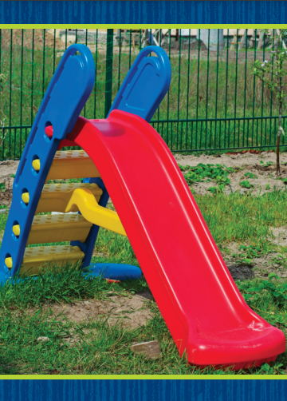
Page 174
Phonics
I can go on a plane.
I can go on a slide.
Notes:
Tell students that today they will read some sentences. The sentences you read will all include sound spellings and high-frequency words you already have learned. Then you will match sentences and pictures.
Write these sentences on the board: I can go on a plane. I can go on a slide. Let’s read the sentences together: I can go on a plane. I can go on a slide. Hold up the slide Picture Card. Which sentence matches this picture? (I can go on a slide.) Click path -> Table of Contents -> Unit 5 Week 5 Drama -> Lesson 5
Have students turn to p. 174 in the Student Interactive. Read the first two sentences with students. Guide them to put an x in the box next to the sentence that matches the picture.
Have students finish p. 174 in the Student Interactive.

Slide 63
Page 174, 175
Apply
Turn to pages 174, 175 in your Student Interactive and complete the activity.
Notes:
Have students finish p. 174 in the Student Interactive.
Have students look at p. 175 in the Student Interactive. Direct them to complete and read the sentences.

Slide 64
High-Frequency Words
new
too
when
Notes:
Remind students that high-frequency words are words that appear over and over in texts.
Remind them they have learned many of the words this year, and the words will help them become better readers.
Say the word new and ask students what letters spell the word.
Have students
say the letters in the word as you write them on the board.
say and spell the word, touching their toes for each letter.
repeat with too and when.

Slide 65
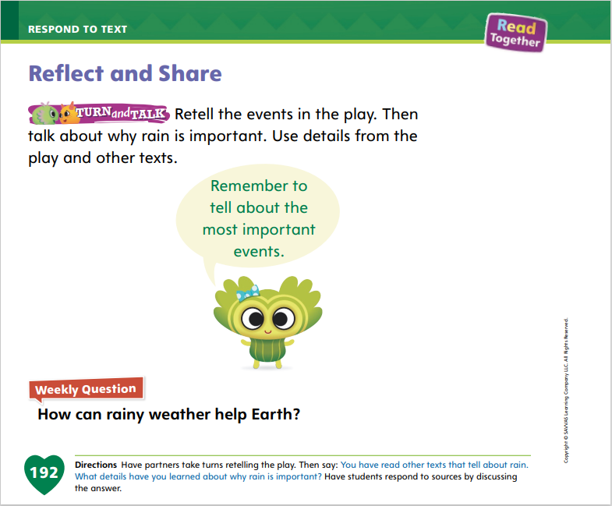
Page 192
Reflect and Share
Turn to page 192 in your Student Interactive and complete the activity.
Notes:
Tell students that it is good to talk to others about texts they read. As they talk with others, they can retell, or summarize, a text in a way that preserves meaning. They can also tell how the text is similar to or different from another text they have read.
Tell students that retelling a text means saying all the important things that happen in the text.
Emphasize that retelling, or summarizing, a text makes it easier to see how the text connects to other texts they have read.
Tell students that when they compare two texts, they can tell how the characters, events, or ideas are alike and different.
Model retelling a text to make connections. In the play we read, Frank and Jenna are sad because it is raining and they can’t play outside. But then they are happy because they see that rain is good. Ask students to think about how your retelling connects to other ideas they have encountered in texts this week. We have read about how rain can be good in other places this week. Rain is good for Frank and Jenna, and rain is good for elephants, too!
Have students work together to complete p. 192 of the Student Interactive.

Slide 66
Page 192
Apply
How can rainy weather help Earth?
Discuss the answer in your group.
Notes:
Have students use evidence and ideas from the texts they have read this week to respond to the Weekly Question.
Tell them to discuss and answer the question in small groups.

Slide 67
Writing – Literary Nonfiction
Remember a question and answer book is …
A nonfiction book about a single topic
A text told in a question-answer format.
A book that includes both text and graphics.
Notes:
Assessments help students and teachers determine what was learned during the unit. Assessments provide information on what skills were learned and what skills may need ongoing practice. This assessment will check what skills were learned about writing question and answer books.
Have students recall some question and answer books from this unit, either in the mentor stack or a book they wrote.
Think aloud as you recall the elements of a question and answer book. Remind students that a question and answer book is
a nonfiction book about a single topic.
a text told in a question-and-answer format.
a book that includes both text and graphics.
Ask students to think about what they have learned from a question and answer book they have read. Engage students in a brief discussion about how question and answer books are organized and formatted.

Slide 68
Writing – Assessment
Notes:
See the unit assessment on p. T403. Inform students that they are going to take a writing assessment. Another form of assessment is to score students’ published writing using the rubric on p. T403.
Provide students with the assessment prompt. The prompt may be displayed for students or may be printed from SavvasRealize.com.

Slide 69
Spelling
I zip my jacket when it is cold.
Mike has a broken leg.
My dad drives, and my mom does too.
My favorite trip is to the lake.
Put the book on the table.
When will it be recess?
Notes:
(Note: Move the orange boxes to cover each bold spelling word before you read aloud the words and sentences.)
Read aloud the words and sentences. Have students spell each word with initial consonant blends and the two high-frequency words.
I zip my jacket when it is cold.
Mike has a broken leg.
My dad drives, and my mom does too.
My favorite trip is to the lake.
Put the book on the table.
When will it be recess?
Reveal the spelling word and have students check their work.

Slide 70
Language and Conventions
There are three cats.
Which phrase could be added to expand the sentence?
is raining.
I am happy.
near the shed.
were dogs?
Notes:
Display the following sentence and guide students to complete the question. There are three cats.
Which phrase could be added to the end to expand the sentence?
is raining.
I am happy.
near the shed.
were dogs?
Have students complete Language and Conventions, p. 288, from the Resource Download Center. Click path: Table of Contents -> Resource Download Center -> Language and Conventions -> U5 W5

Slide 71
Unit 5: Week 5
Grade K

